Slide 1


Fundamentals of Git and GitHub
Git is a version control system for tracking code changes. GitHub is a platform for hosting and collaborating on Git repositories. Together, they enable efficient software development and collaboration.
by David Ouma

Slide 2

Getting Started with Git
1
Install Git
Download and install Git on your system.
2
Configure Git
Set up your username and email using git config commands.
3
Initialize Repository
Create a new Git repository with git init.

Slide 3
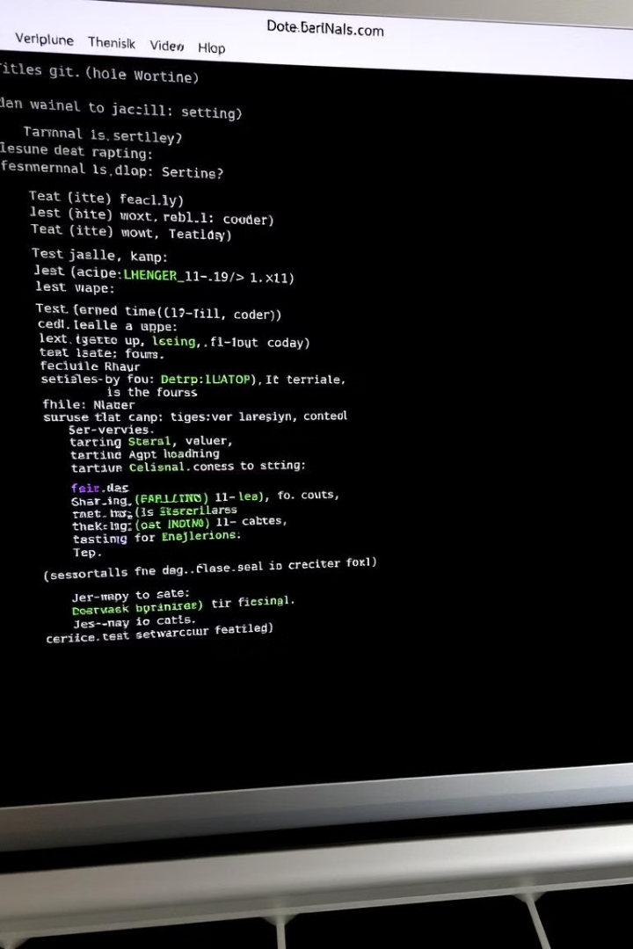



Basic Git Commands
git add
Add changes to the staging area.
git commit
Save changes in the repository with a message.
git status
Check which files are staged, unstaged, and untracked.

Slide 4
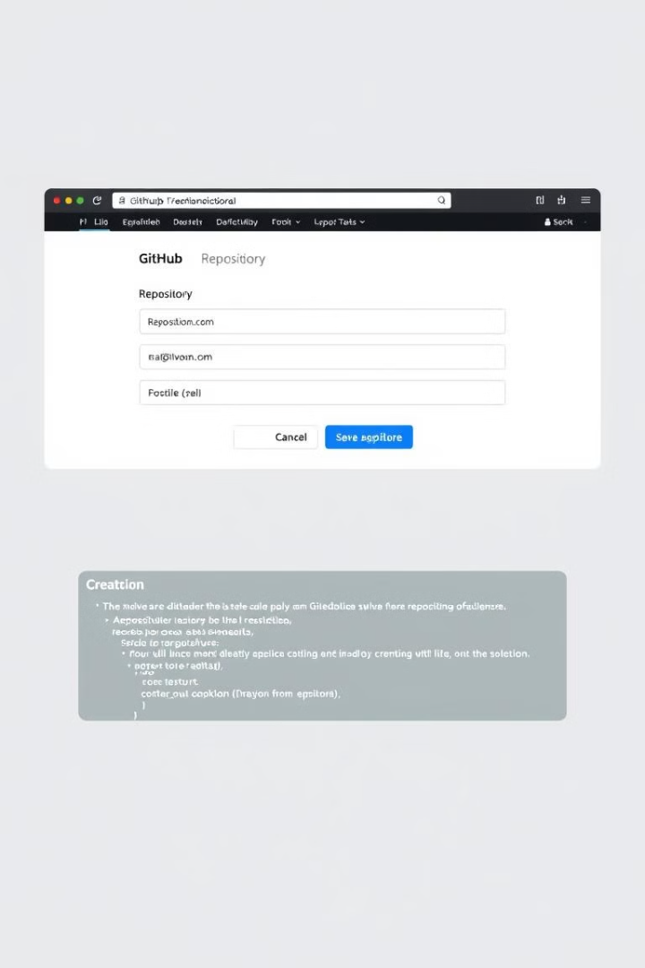
GitHub Essentials
1
Create Repository
2
Push Local Repository
Set up a new repository on GitHub.
Use git remote add and git push to upload local code.
3
Collaborate
Invite others to contribute to your project.

Slide 5




Branching in Git
Create Branch
Use git branch to create a new branch.
Switch Branch
Use git checkout to move between branches.
Merge Branches
Combine changes from one branch into another with git merge.

Slide 6
Collaborative Features on GitHub
Forking
Pull Requests
Issues
Create a copy of someone else's repository on your GitHub account.
Submit changes for review and integration into the main project.
Track bugs, enhancements, and tasks within a project.

Slide 7
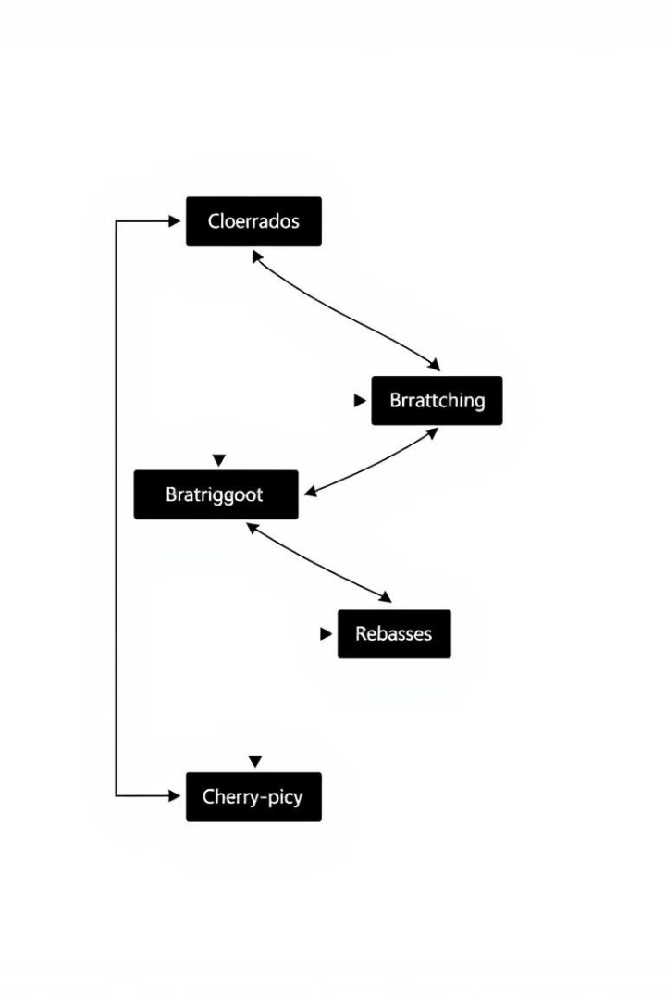
Advanced Git Topics
Rebasing
Stashing
Clean up commit history and integrate changes from one branch to another.
Temporarily save changes when switching branches.
Interactive Rebase
Edit, reorder, or squash commits using git rebase -i.

Slide 8

Advanced GitHub Actions
GitHub Actions
Automate workflows like testing and deployment
GitHub Pages
Host static websites directly from a repository
Branch Protection
Set rules to restrict direct pushes to critical branches

Slide 9
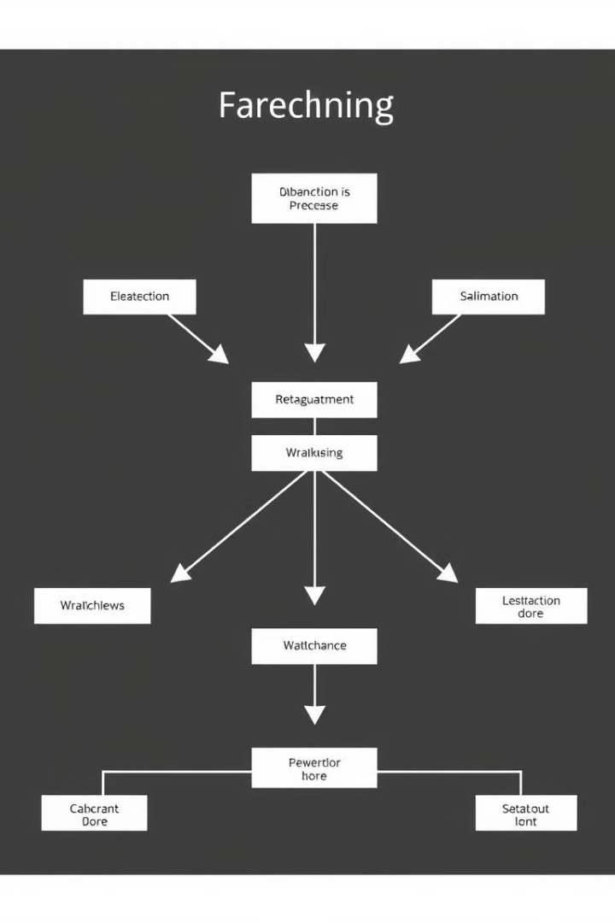
Advanced Branching Strategies
1
Feature Branch Workflow
Develop each feature in its own branch.
2
Git Flow
Use multiple branches for different stages of development.
3
Trunk-Based Development
Work on a single main branch with short-lived feature branches.

Slide 10

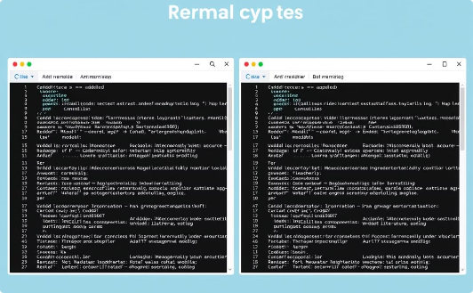
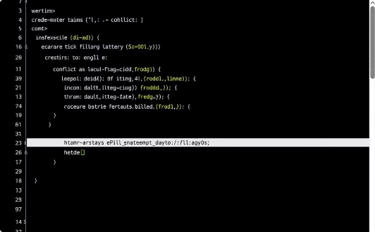
Resolving Conflicts
Merge Conflicts
Merge Tools
Manual Resolution
Resolve conflicts when merging branches with conflicting changes.
Use visual tools like kdiff3 or meld to resolve conflicts.
Manually edit files to resolve conflicts and remove conflict markers.

